Slide 1
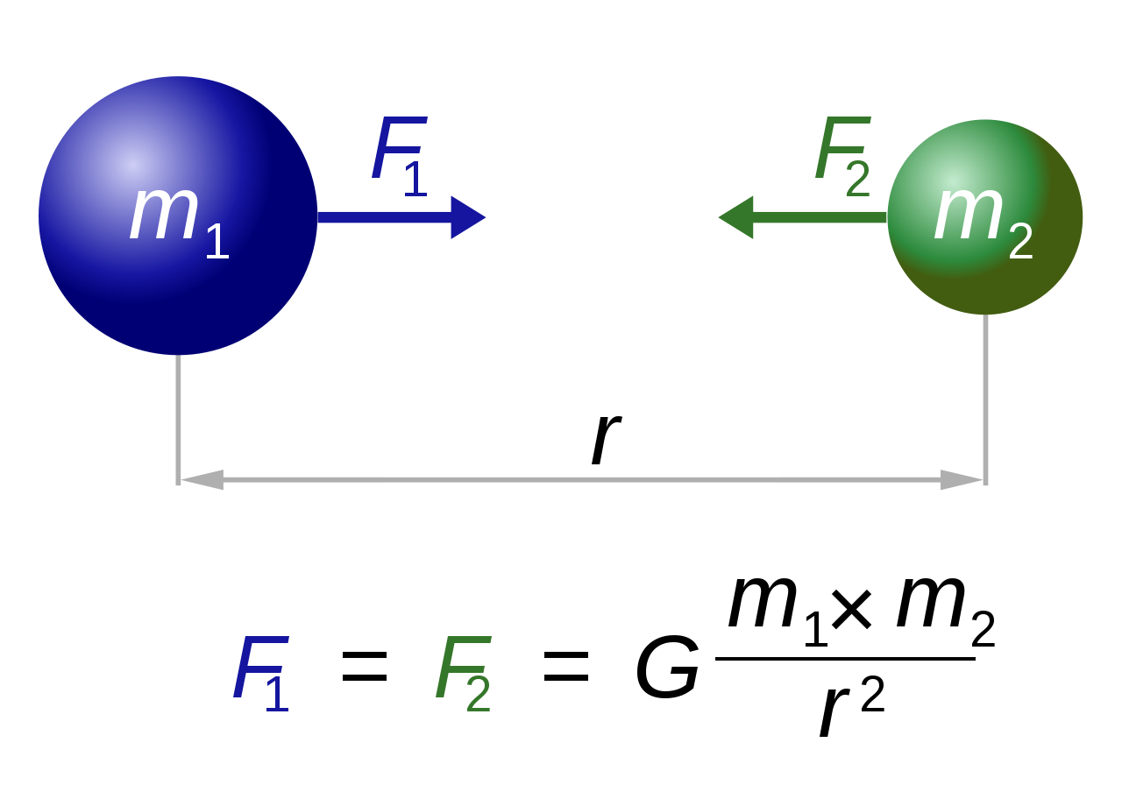
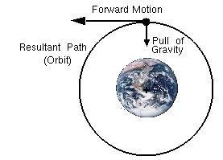
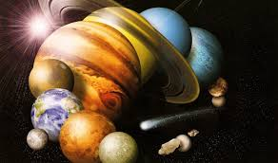
Universal Gravitation
Gravity
Law of Universal Gravitation
Inverse-Square Law
Extraterrestrial Gravity
Objects in Circular Orbit
Geosynchronous Orbits
Our bodies in microgravity
Interplanetary Travel

Slide 2
Gravity is everywhere
Gravity is present wherever there is matter
Thus, all material things are exerting a force on all other material things

Slide 3
Law of Universal Gravitation
F = Force of gravity between the two objects
G = Universal gravitational constant = 6.67 x 10⁻¹¹ Nm²kg⁻²
m₁ and m₂ are the masses of the objects in kg
r = distance separating the two objects (center to center)

Slide 4
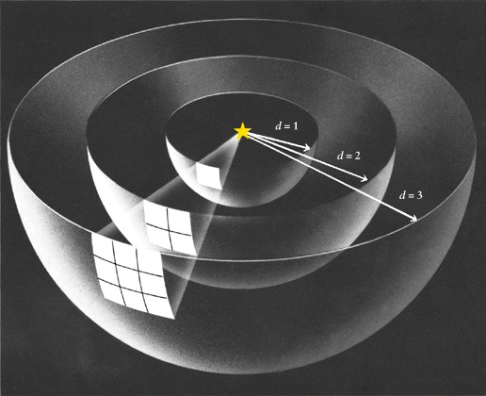
Inverse squares – 1/r² Notice the large increase with each increment

Slide 5
Considerations
Gravity acts between two objects.
Equal forces acting in opposite directions.
Masses must be large to notice a g force
i.e. the Earth doesn’t notice our individual pull on it but we notice its pull on us. This is why you cannot fly
Further apart = smaller force of gravity
Never zero. In space we experience very little gravity due to increased distance from any large mass. This is called microgravity.

Slide 6
The Power of G
Extraterrestrial Gravity
Gravitational acceleration on other planets can be calculated using this law, as long as the mass of the planet is known

Slide 7
Extraterrestrial Gravity
Planet
Radius (m)
Mass (kg)
g (m/s²)
Mercury
2.43 x 10⁶
3.2 x 10²³
3.61
Venus
6.073 x 10⁶
4.88 x10²⁴
8.83
Mars
3.38 x 10⁶
6.42 x 10²³
3.75
Jupiter
6.98 x 10⁷
1.901 x 10²⁷
26.0
Saturn
5.82 x 10⁷
5.68 x 10²⁶
11.2
Uranus
2.35 x 10⁷
8.68 x 10²⁵
10.5
Neptune
2.27 x 10⁷
1.03 x 10²⁶
13.3
Pluto
1.15 x 10⁶
1.2 x 10²²
0.61

Slide 8
Check Your Understanding
Earth’s gravitational pull on a spacecraft some distance away is 1.2 x 10² N in magnitude. What will the magnitude of the force of gravity be on a second spacecraft with 1.5 times the mass of the first spacecraft, at a distance from Earth’s centre that is 0.45 times as great?
Solution: F₂ = 8.9 x 10² N

Slide 9
Check Your Understanding
Determine the magnitude of the force of attraction between two uniform metal balls, of mass 4.00 kg, used in women’s shot-putting, when the centres are separated by 45.0 cm.
Solution: F = 5.27 x 10⁻⁹ N

Slide 10
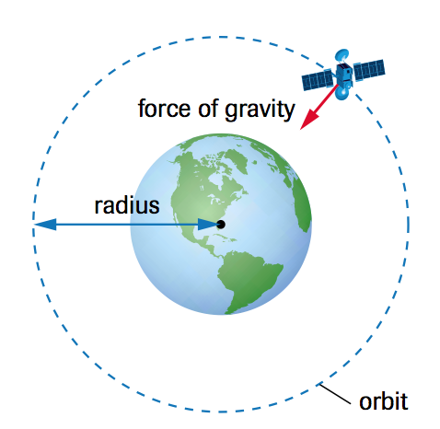
Objects in Circular Orbit
Objects in space orbit larger masses due to the force of gravity between them.
Then why isn’t an object that is orbiting another in space (i.e. a TV satellite in outer space) simply get pulled down to the surface?

Slide 11
Objects in Circular Orbit
An object in circular orbit (like a satellite) has forward motion but is constantly being pulled by the force of gravity towards Earth.
If the orbiting object maintains its forward motion without changing its distance from Earth, it will continually “fall” around Earth in a circular orbit.

Slide 12
Objects in Circular Orbit
To analyze the motion of objects in circular orbit, we combine Newton’s law of universal gravitation with the equation for centripetal acceleration involving speed.
We can also use our equations for frequency and orbital period

Slide 13
Check Your Understanding
The Hubble Space Telescope (HST) follows an essentially circular orbit, at an average altitude of 598 km above the surface of Earth.
G = 6.67 x 10⁻¹¹ Nm²/kg2 m_{E} = 5.98 x 10²⁴kg
Distance from Earth’s core to the surface = 6.38 x 10⁶ m
Determine the speed needed by the HST to maintain its orbit. Express the speed both in metres per second and in kilometers per hour.
Solution: v = 7.56 x 10³ m/s & v = 2.72 x 10⁴ km/h

Slide 14
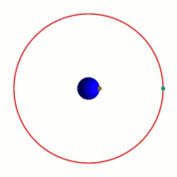
Geosynchronous Orbits
Special kind of orbit
This means the object stays in the same place relative to the Earth
Will always point to the same location
Useful for communication satellites
Altitude = 35,786 km
v = 3070 m/s
T = 23.93446 hours

Slide 15
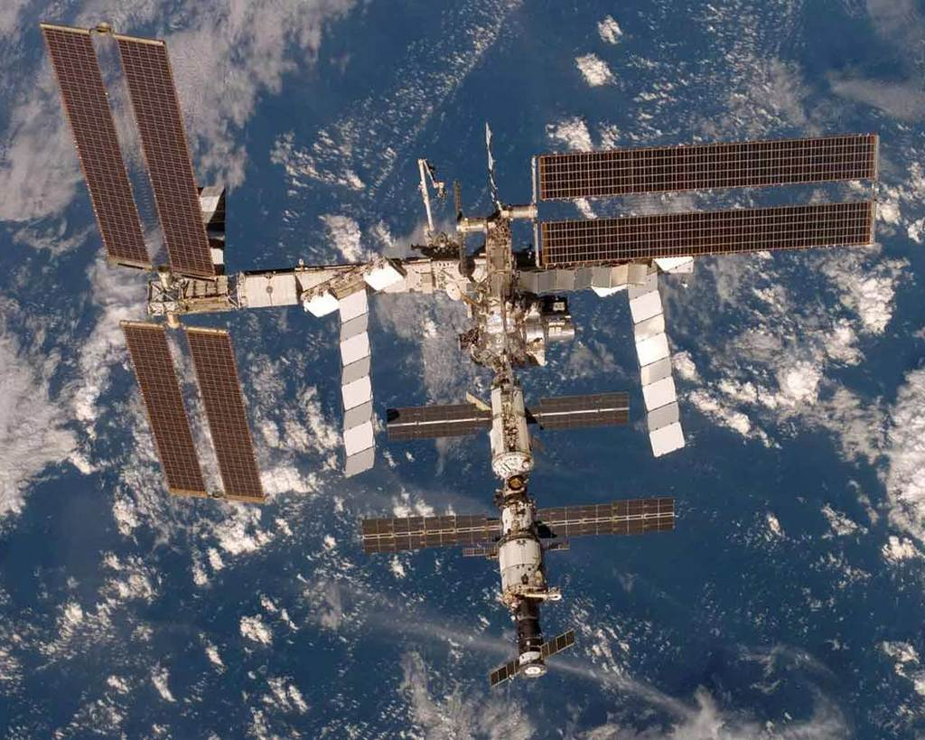
Our bodies in microgravity
The absence of forces against the muscles (caused by microgravity) has significant long-term health consequences
Muscle atrophy
Loss of bone calcium
Organ swelling (heart, kidneys)
The ISS does not have artificial gravity

Slide 16
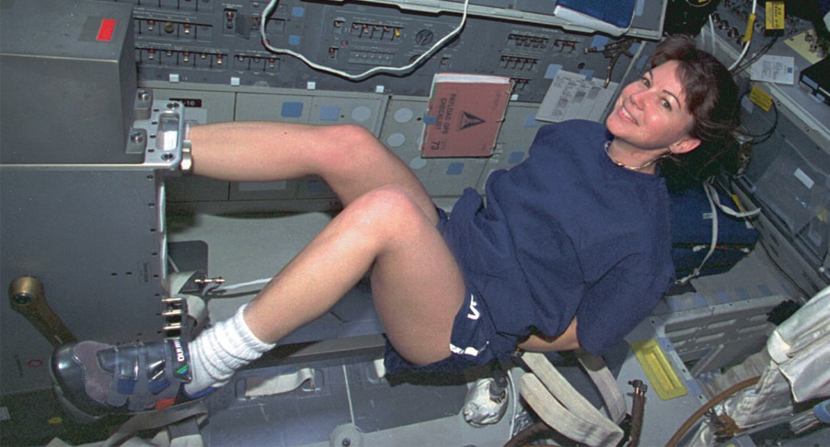
Interplanetary Travel
Currently astronauts have a rigorous exercise regime to limit these effects

Slide 17
Long-term solutions
Any interplanetary mission (to Mars or beyond) or permanent space colony must simulate gravity for the health of participating astronauts/scientists
Can be done using the principals of circular motion

Slide 18
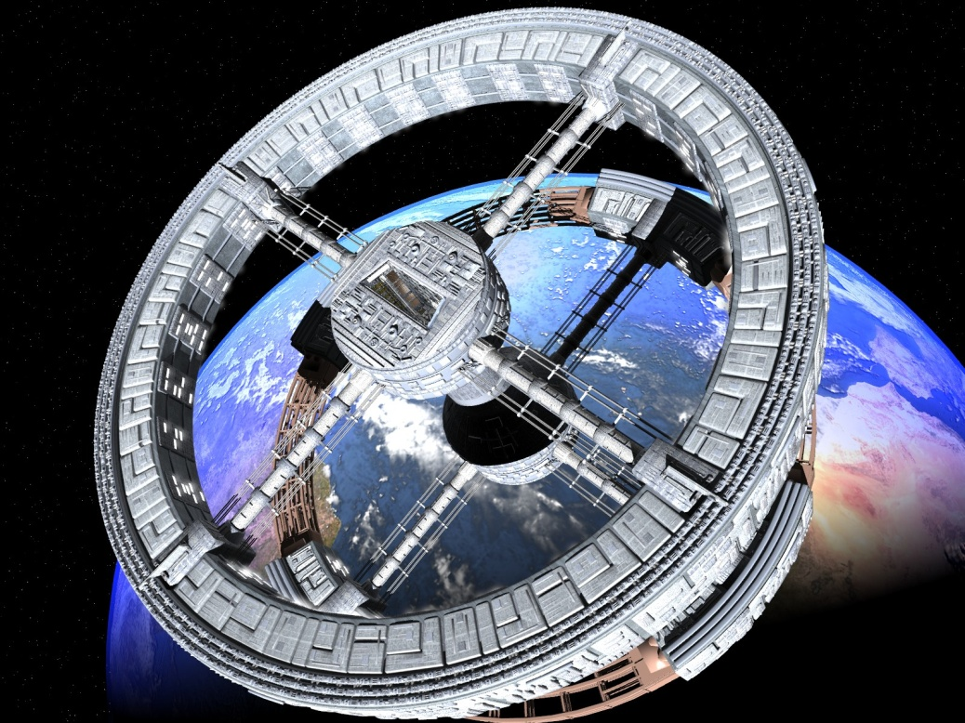
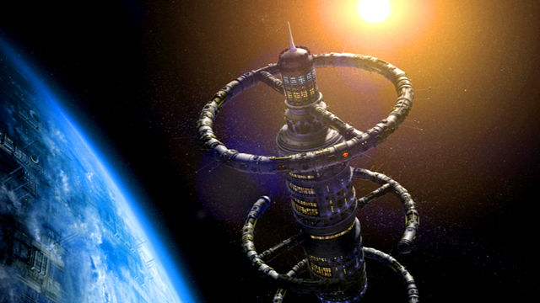
Proposed space colonies

Slide 19
Check Your Understanding
A cylindrical space craft travelling to Mars has an interior diameter of 3.24 km. The craft rotates around its axis at the rate required to give astronauts along the interior wall an apparent weight equal in magnitude to their Earth-bound weight. Determine:
the speed of the astronauts relative to the centre of the spacecraft and
the period of rotation of the spacecraft.
Solutions: a) v = 126 m/s b) T = 80.8 s

